Slide 1
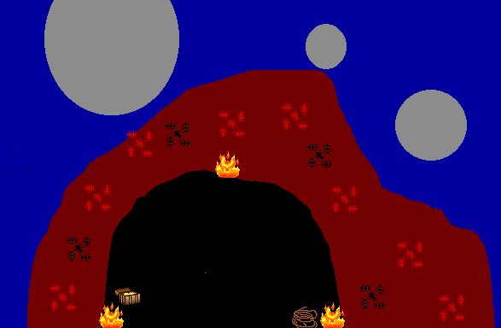
The Hollow Stone
By 3W
Click here to begin

Slide 2
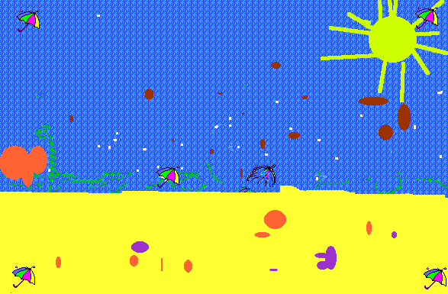
You are in Queensland for your holiday. You are staying at the beach for one day in a beach house .
The next day you go for a walk with your family. You walk behind everyone. Mum calls out, “Where are you?” but you don’t hear her.
Your mum thinks that you are coming.
Then you look up and you can’t see your family.
After 1 minute your mum comes looking.
“At last I found you!” says your mum.
Click here to continue

Slide 3
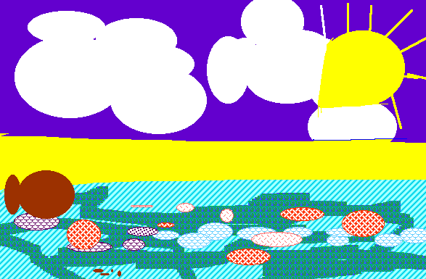
“What’s this?” you say to your mum. She doesn’t have a clue either. It sort of looks a bit like a sea shell. You notice a trail of them leading into a cave. Your mum doesn’t notice as you walk over to have a look. Click here to enter the cave.

Slide 4
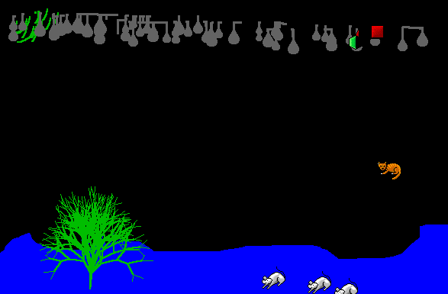
The cave is a truly wonderful place. You’re not sure which way to go when you see tunnels going off to the left and right. Which way would you like to go? Left or Right

Slide 5
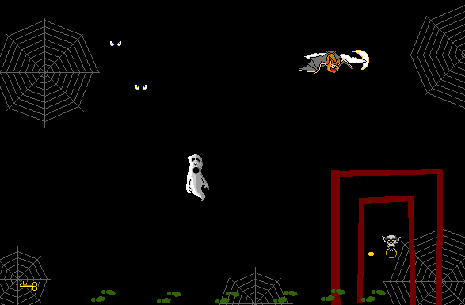
In a dark dripping cave you walk along the mud floor. Suddenly you find a key on the ground. You pick it up and keep walking. You come to a pit of crocodiles but are able to swing across on a rope. On the other side is a door. You have already been gone for a long time and are getting tired and hungry. Do you go back where you were or open the door?

Slide 6
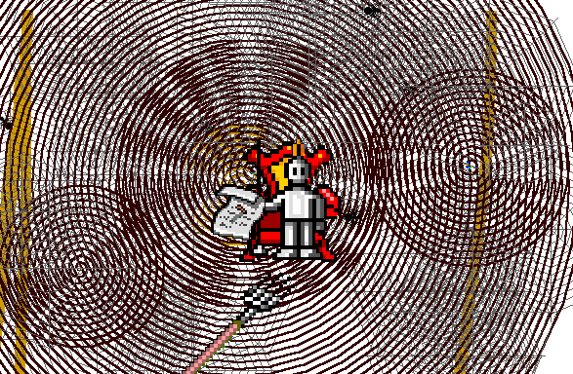
You enter into an old room with cobwebs and a lot of dust. You walk quietly and slowly step by step. Suddenly you step on a broom which lifts up a chair with a skeleton in it. You see it holding a note. You take the note and read it. Click here to see what it says.

Slide 7


It’s a treasure map!
Lucky are you
To be in this cave
But if you want treasure
You’ll have to be brave
You won’t be the first
To seek fortune and fame
Now continue ahead or
Go back where you came?

Slide 8
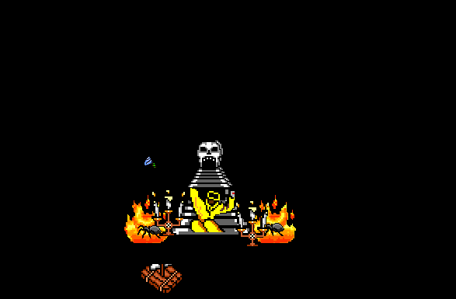
You are walking down the rusty path and a big monster jumps just as you bang your foot on something. It’s a trapdoor. Should you stay and fight the scary monster or should you go down the trap door?

Slide 9
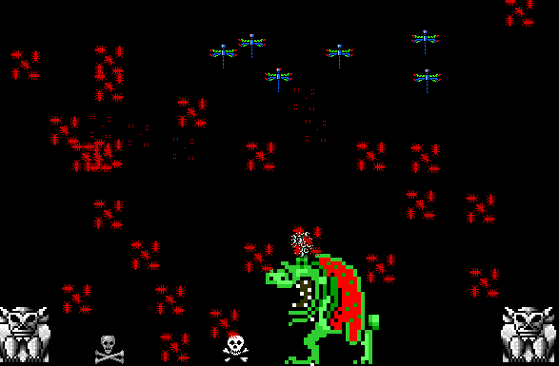
Bad move! You give him a punch in the arm. He gives you a punch so hard that you die. The End Click here to start again

Slide 10
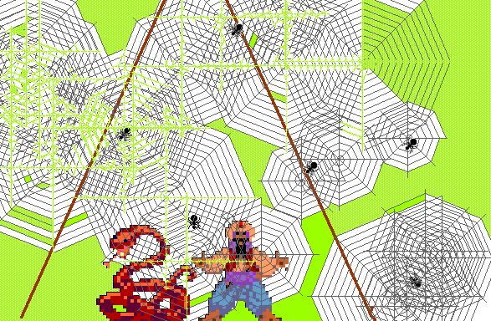
You continue going through the cave with the python. You are getting tired and you start to wonder if you should be making your way back home. You now realise you are lost and you become very scared! Click here to continue.

Slide 11
You keep looking on your own but become very tired and hungry. Will you keep looking or try to find your way back to the beach?

Slide 12
You step through the trapdoor
and find a person called Professor Dumb Scott.
You both talk for a little while.
Finally, Professor Dumb Scott notices the map in your pocket.
“What is in your pocket?” he says.
Do you
show him the map
or
keep the map to yourself?

Slide 13
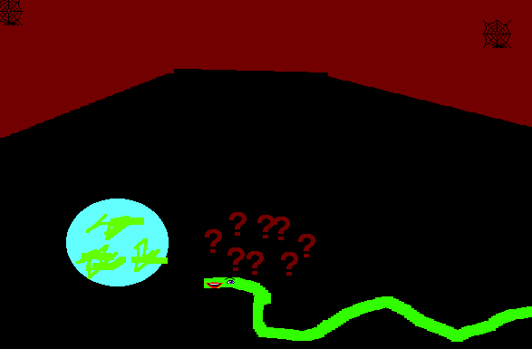
Oh no! You can’t get out of here! “There is no way out of here” says the python. “No other place exists” “No. There is more to the world than just this cave” you tell him. “There are flowers, there is sunshine. I don’t know how you could live here!” The python decides to take you to meet a man called Ivan who will know if there’s an outside world. Click here to continue.

Slide 14
You keep on walking with the python and then
suddenly there is a monster in front of you!
You decide to fight.
You give him a good kick but you start to lose the fight.
Lucky for you the python wins the fight for you.
Click here to continue

Slide 15

This Ivan person is wise but he’s not as clever as you had hoped.
He knows nothing about the outside world and doesn’t even ask
as he thinks you are making it up.
Will you
stay there with Ivan
or
continue looking?

Slide 16
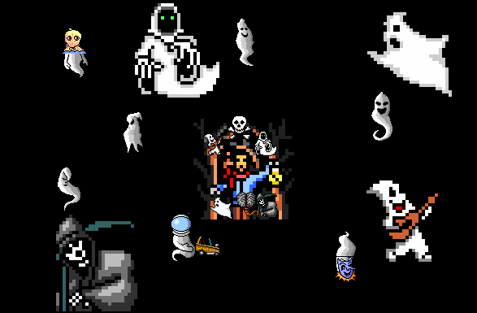
You go upstream for a very long time. The stream gets smaller and smaller until there is just a small trickle coming out of the wall.
You know you will never make it back so you stay there until you die of hunger.
The End.
Click here to start again

Slide 17
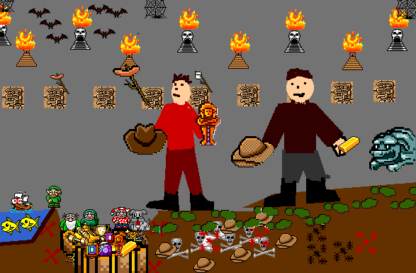
With Professor Dumb Scott’s help you find the treasure and live happily ever after. The End Click here to start again

Slide 18
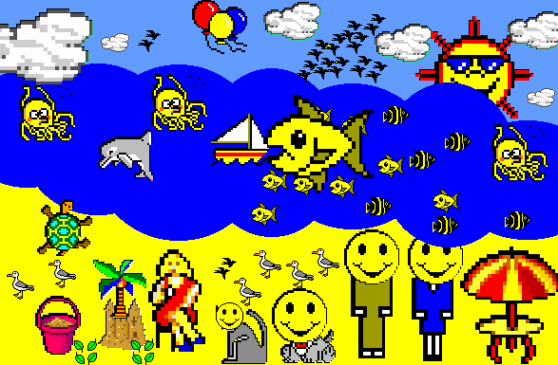
As you follow the river downstream it gets bigger and bigger. It finally goes into the ocean which means you made it safely back to the beach! The End Click here to start again

Slide 19
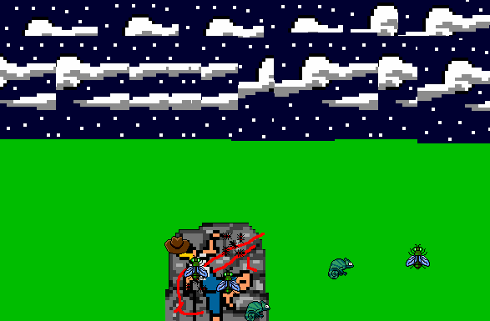
You keep on walking and you get hungry. You see a rock and you fall asleep. Because you have decided to be alone there is no one to help you. Eventually you die. The End Click here to start again

Slide 20
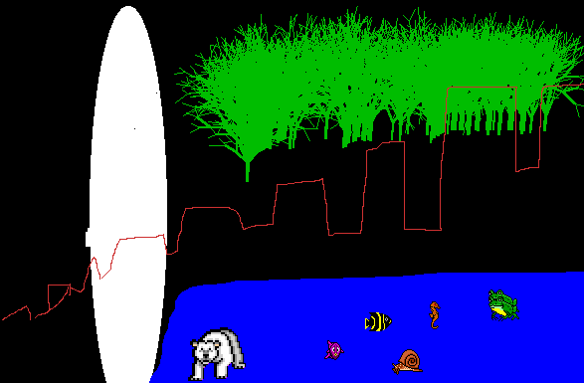
You go through a door and out to a river Do you want to follow the river upstream or downstream?

Slide 21
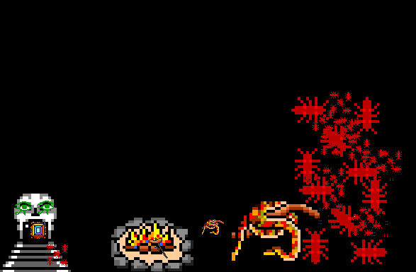
You meet a huge python and at first you fear the worst.
It’s a talking python and he explains that he will not harm you.
Do you
believe him and stay
or
leave and go back to the entrance of the cave?

Slide 22
Although you know there is an outside world you have
given up hope of ever making it back.
You stay in the cave for the rest of your life.
You’re not even sure how long that is because you
can’t tell day from night without the sun.
You will never see another sunset or rainbow again
The End
Click here to start again.

