Slide 1
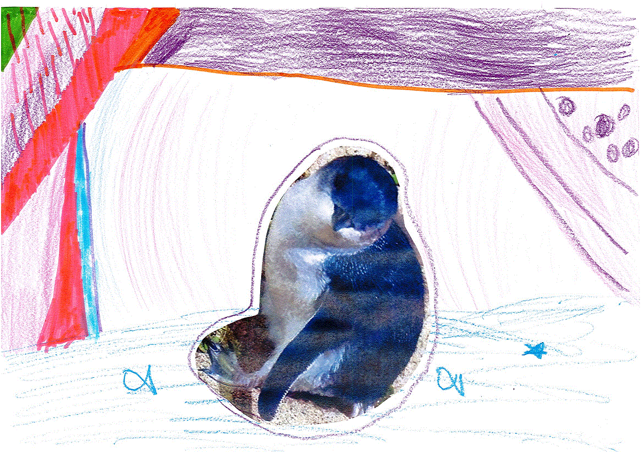
The Adventures of Fiona the Fairy Penguin
Click here
to start her
adventure

Slide 2
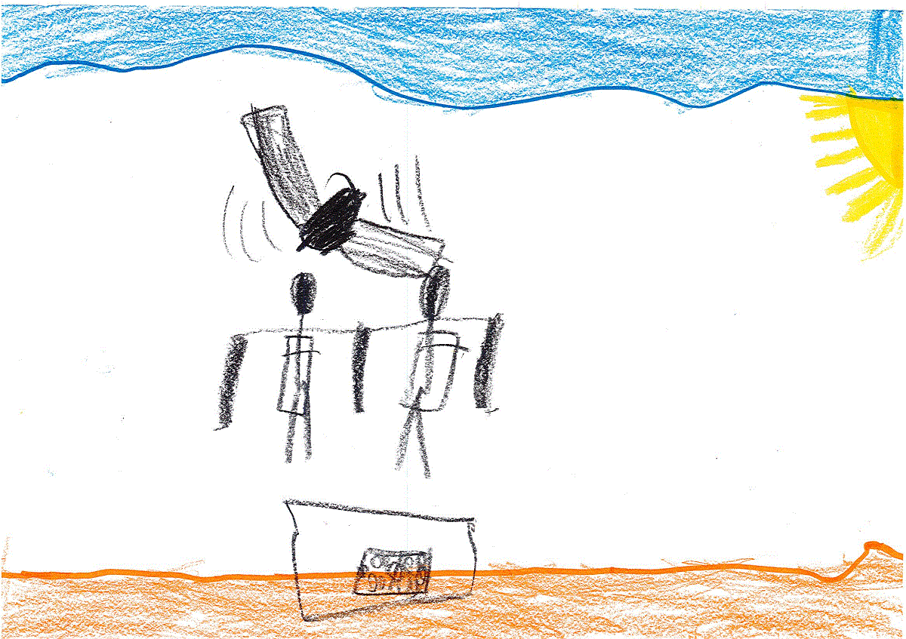
One day, Oscar and his family went to Phillip Island to see the Fairy Penguins. At first, nothing happened but after a while, hundreds of penguins came out of the sea.
As they were getting in the car to leave, Oscar saw a penguin jump into the boot of their car.
Click here to continue.

Slide 3
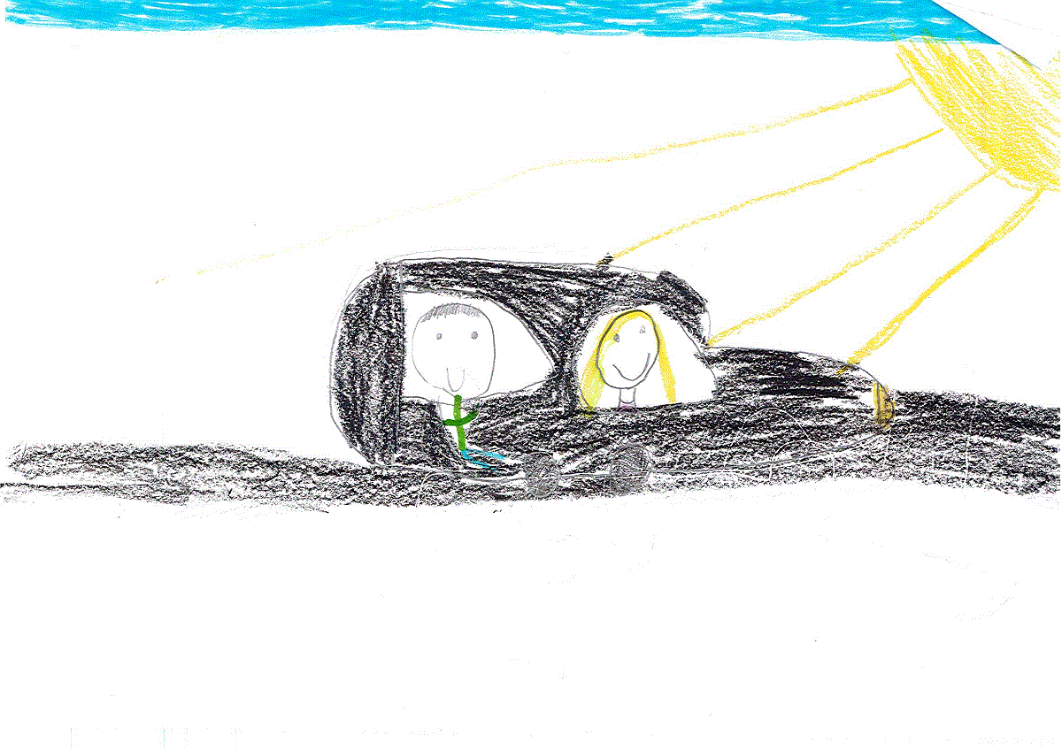
Oscar’s parents had not seen the penguin jump into the car. As the car drove through the car park, Oscar wondered if he should tell his parents.
Should he tell his parents
or keep it a secret?

Slide 4
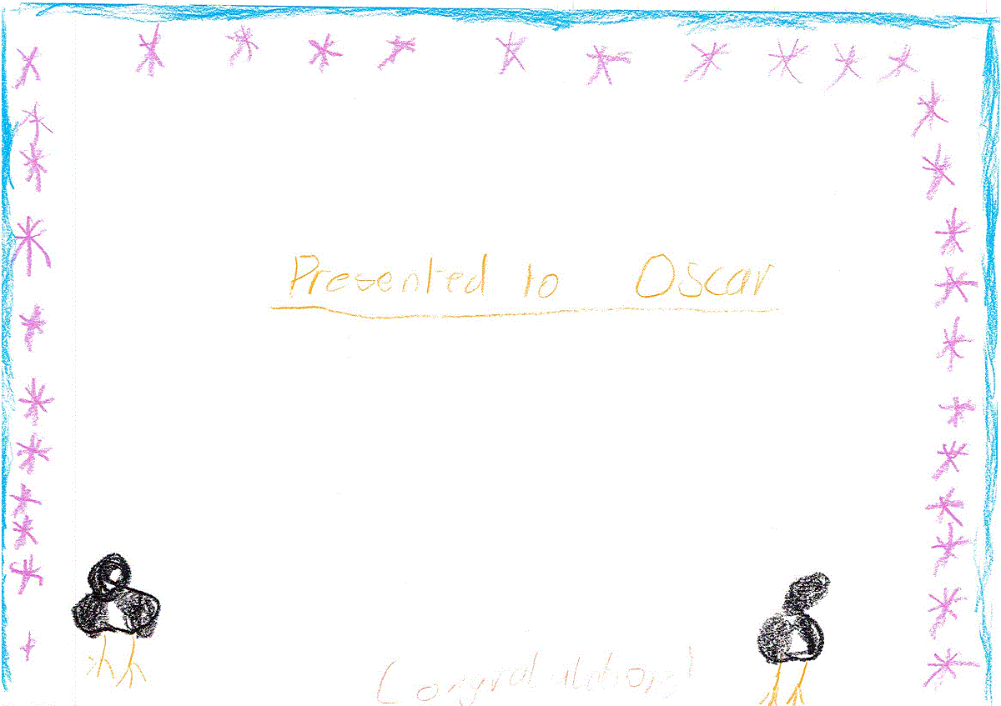
Presented to Oscar
Oscar’s parents parked the car and went inside to tell the manager. The manager came outside with a net and a box and put the penguin safely inside so he could carry it back to the other penguins.
He was so thankful that he decided to give Oscar an award for doing the right thing.
The end. Click here to start again

Slide 5
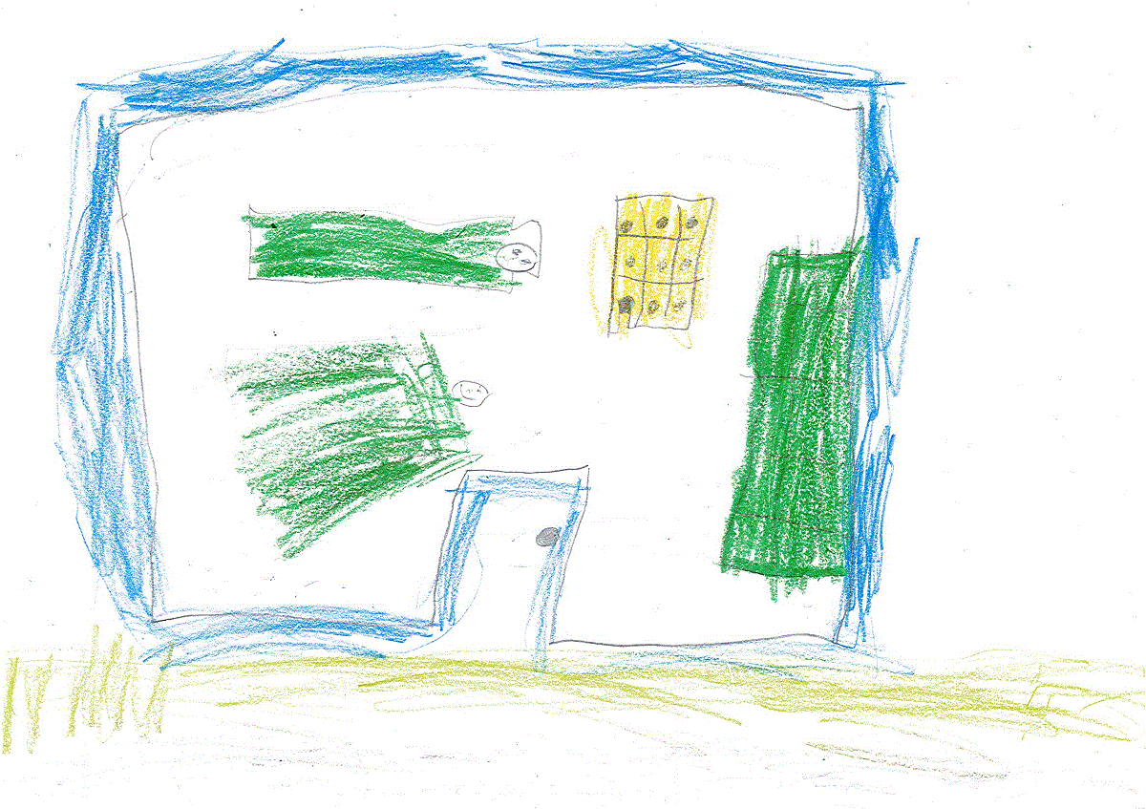
Oscar was on his way to a sleepover for Luke’s birthday party. He decided to name the penguin “Fiona” and he sneakily got Fiona out of the car without anyone noticing.
Click here to see what happens next.

Slide 6
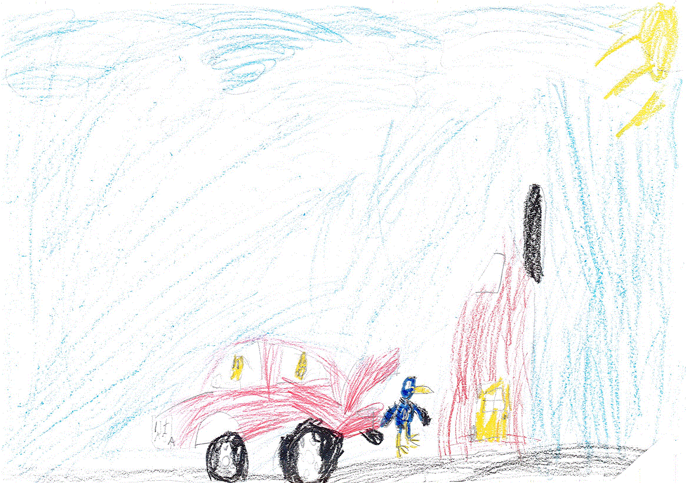
Fiona ran away from Oscar and Luke so they chased after her. “Come back here!” they shouted but Fiona kept running.
Click here to follow Fiona as she tries to escape from the boys.

Slide 7
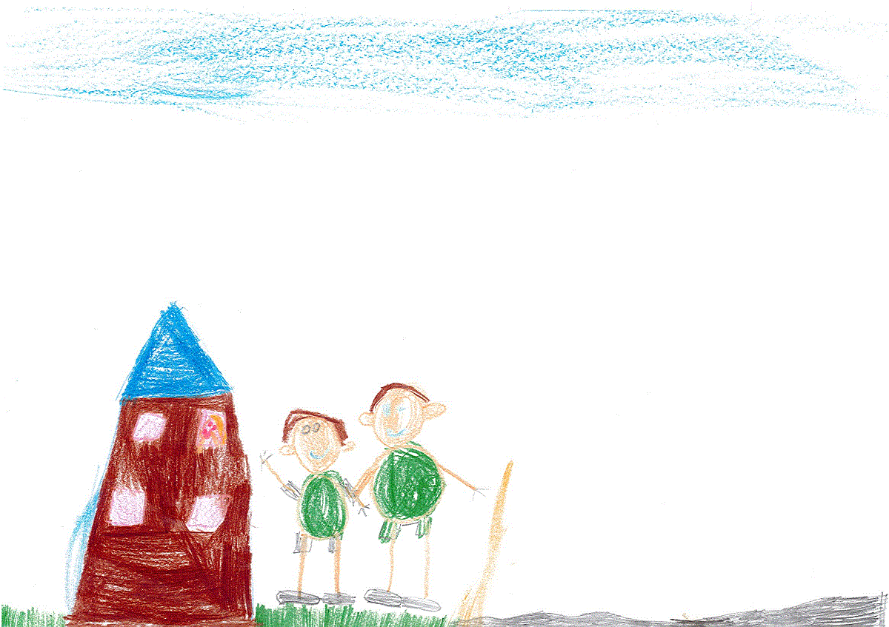
Matilda was trying to sleep when she heard the boys shouting so she opened her window. “Who’s Fiona?” she asked.
While Oscar and Luke explain how they got the penguin, Fiona keeps running and they lose sight of her.
Click here to continue.

Slide 8
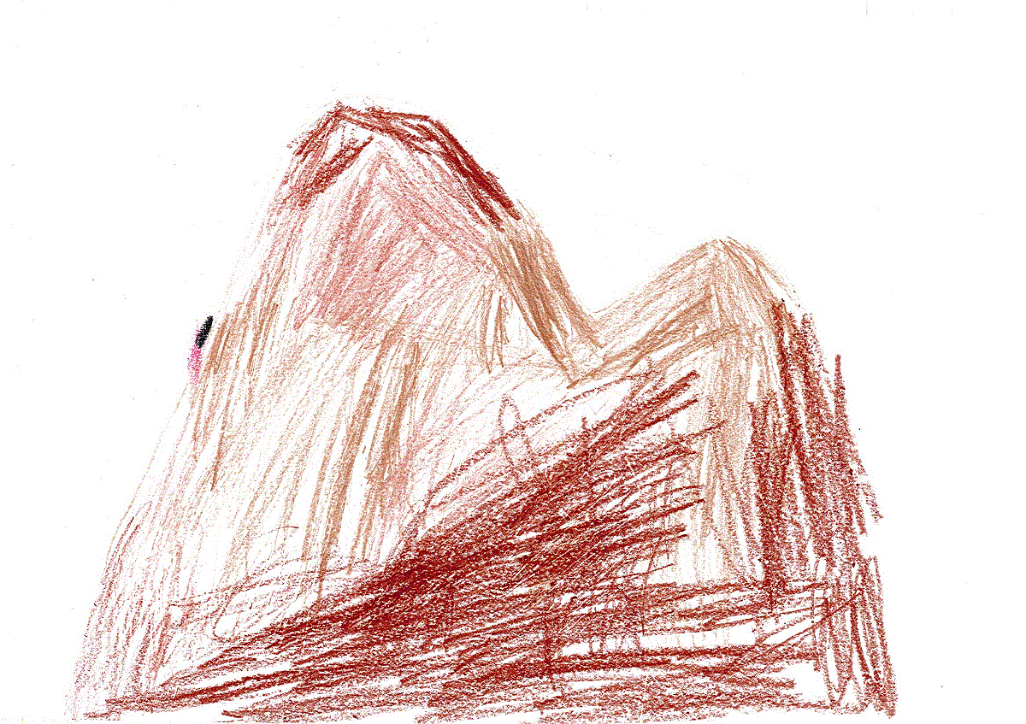
Fiona went upstream for as long as she could. The river got smaller and smaller until it was just a trickle. Fiona died from exhaustion and lack of food. The end.
Click here to start again.

Slide 9
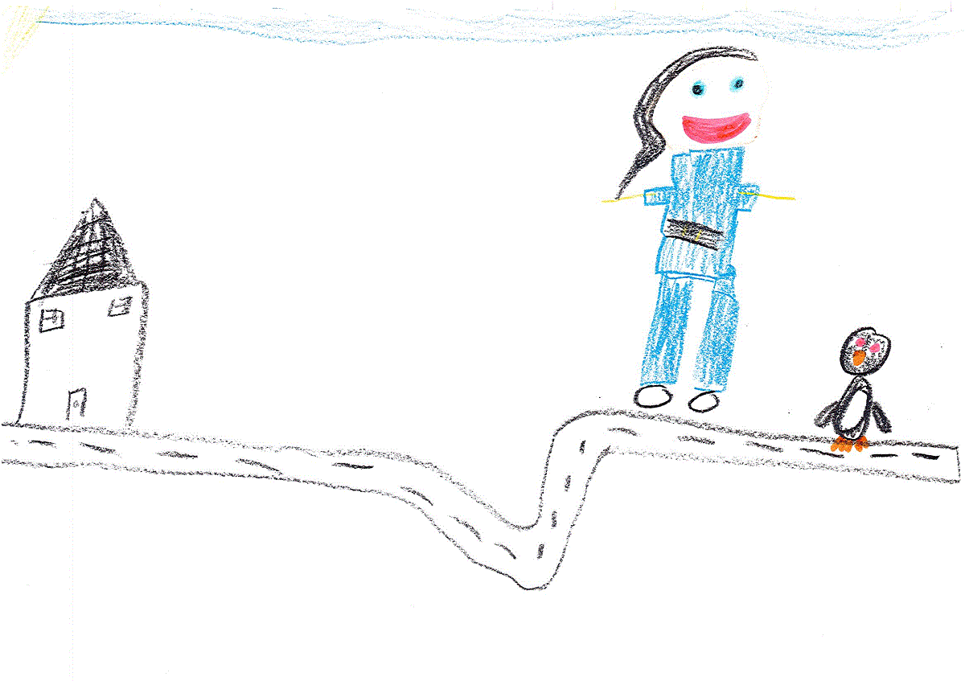
As Fiona continued to run from the boys, she came across a police woman named “Olivia”.
Olivia would have been able to help Fiona get back to Phillip Island but Fiona was scared of Olivia because she looked like a big blue penguin in her uniform.
Fiona fell asleep while she was hiding in some bushes.
Click here to continue.

Slide 10
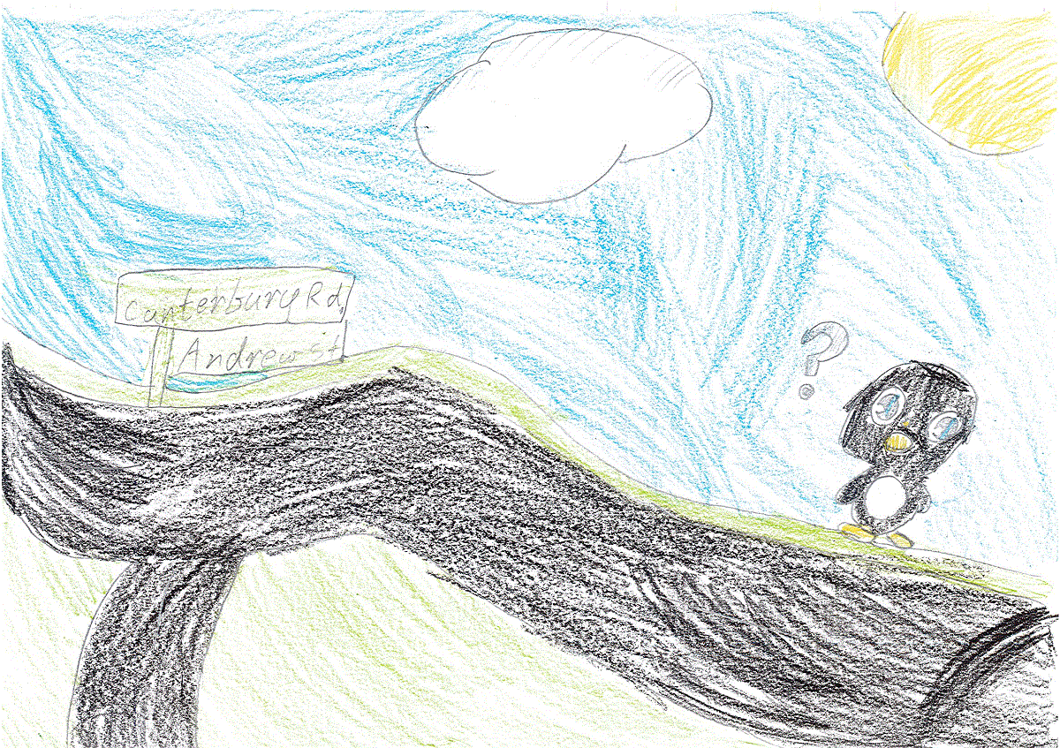
The next morning, Fiona tried to find her way home by looking at a street sign at the end of Andrew Street in Vermont.
Should she go left at Canterbury road or right?

Slide 11
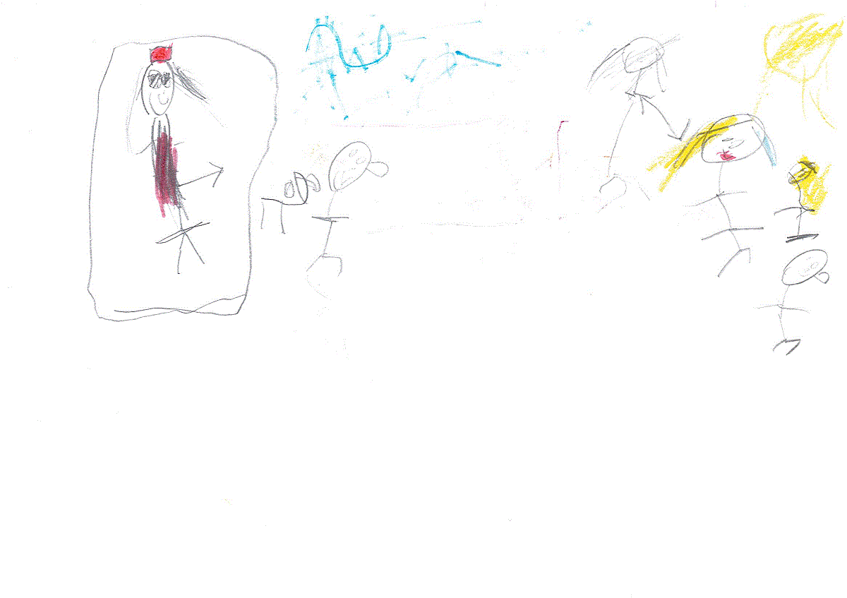
Fiona saw Alice and her brother Douglas playing in their backyard. There was a big plum tree so Fiona tried to eat some fruit. Alice’s dog Fletcher chased Fiona so she jumped over the fence to get away.
Click here to jump over the fence.

Slide 12
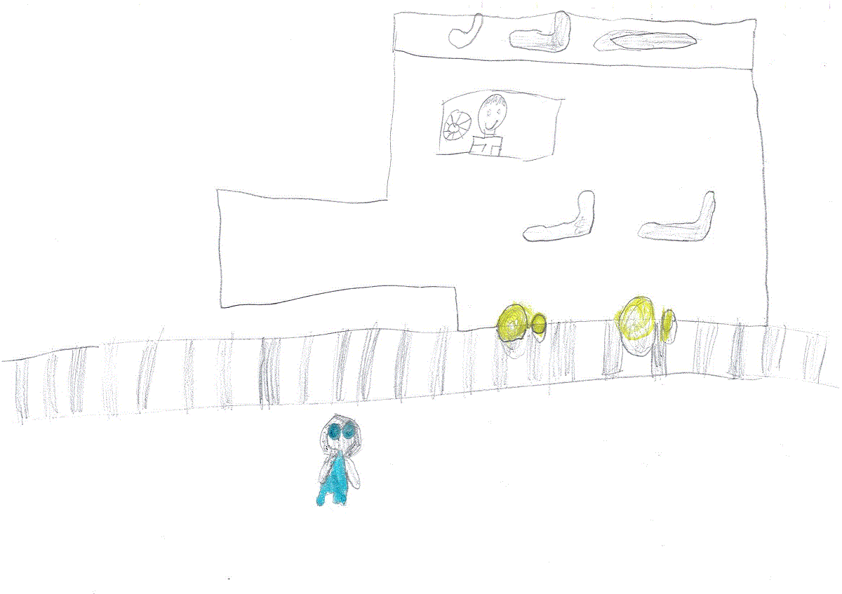
Fiona was spotted by Dylan and Grace. They thought that the penguin looked hungry so they wondered if they should feed her or not.

Slide 13
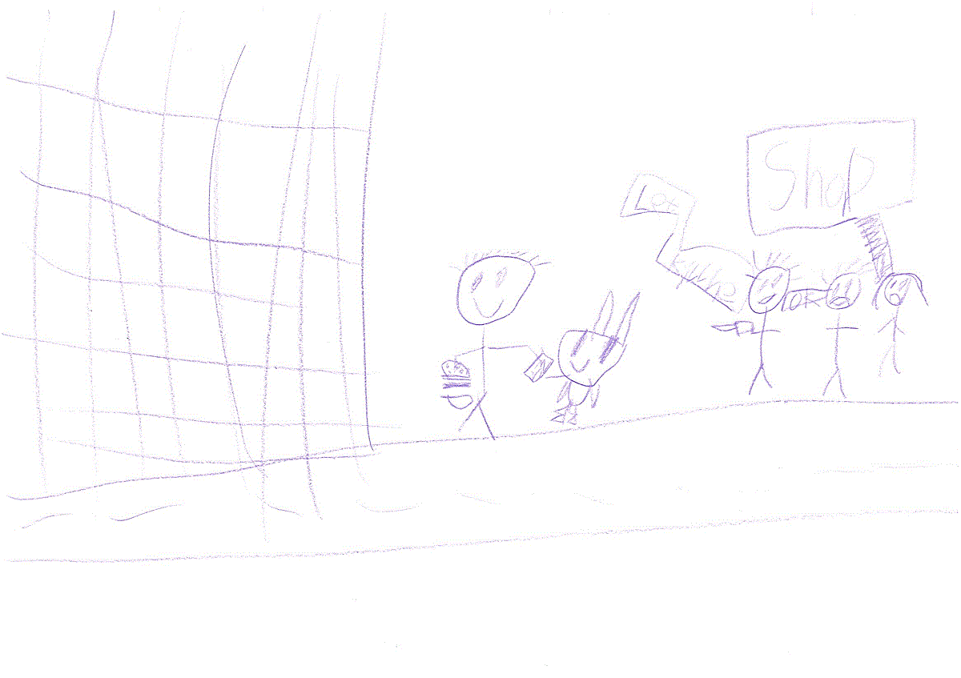
Dylan and Grace gave Fiona some canned fish to eat and some water to drink. Fiona started to feel better so she had the strength to keep on going.

Slide 14
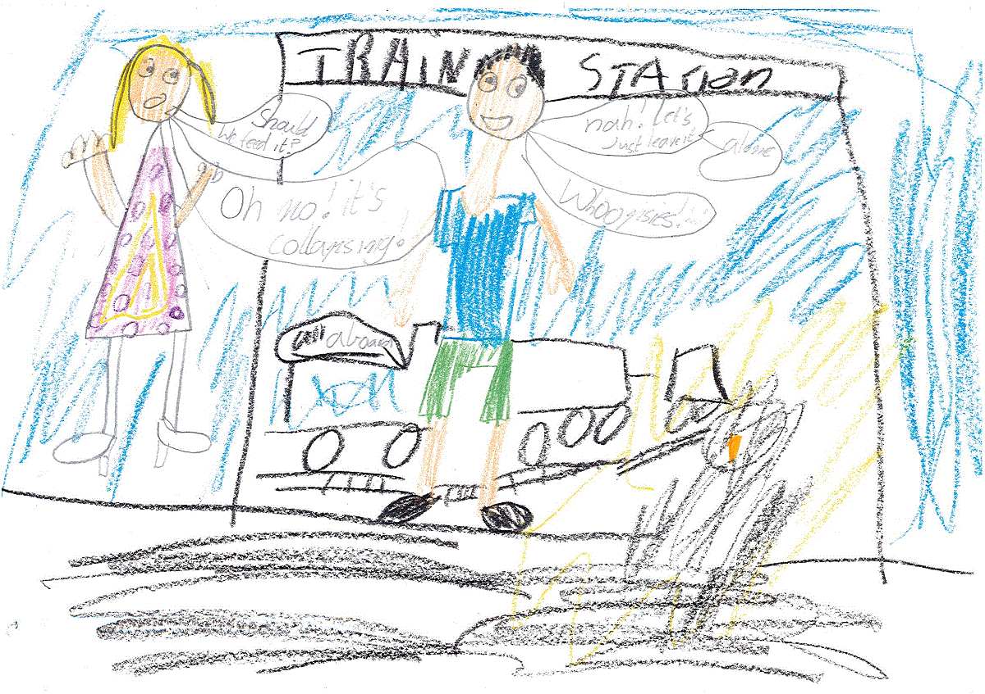
You decided not to feed the penguin because it was a wild animal.
Fiona collapsed from exhaustion so you took her to the vet.

Slide 15
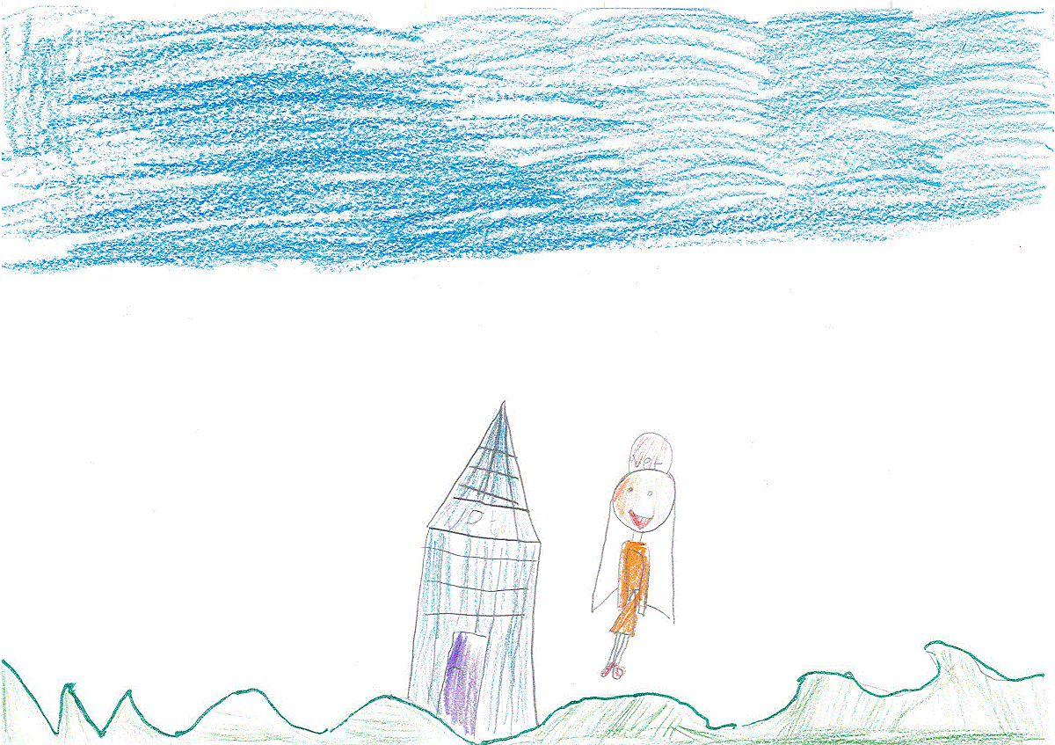
The vet was a nice lady called “Flora”. They had to wait a long time because Flora was busy seeing Emily and her eleven chickens.
When Flora had fixed up Fiona, she knew that Fiona had to be taken somewhere else.
Click here to see where Flora took Fiona.

Slide 16
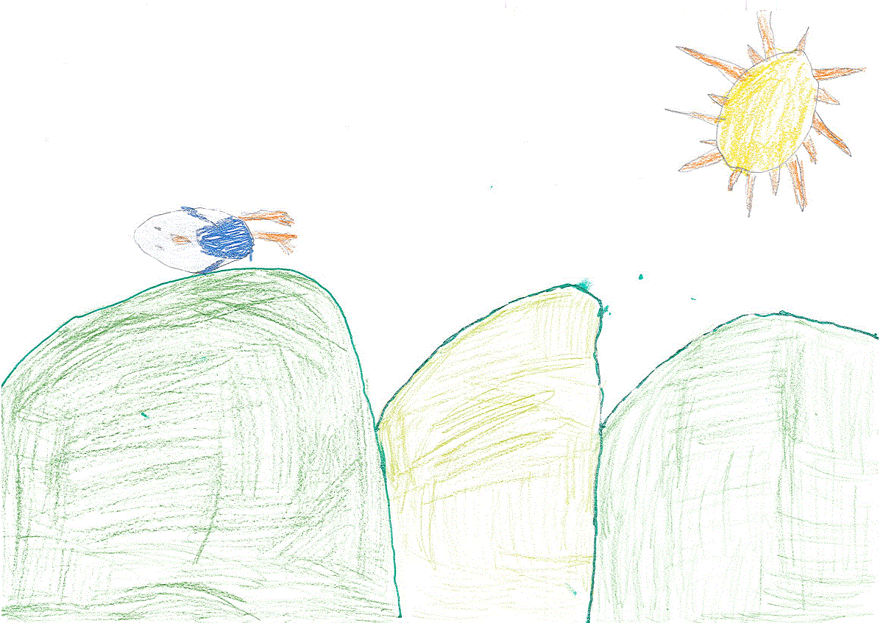
Fiona walked and walked until she came to the Dandenong Mountains. It was beautiful in the mountains but Fiona was still lost!
Click here to continue.

Slide 17
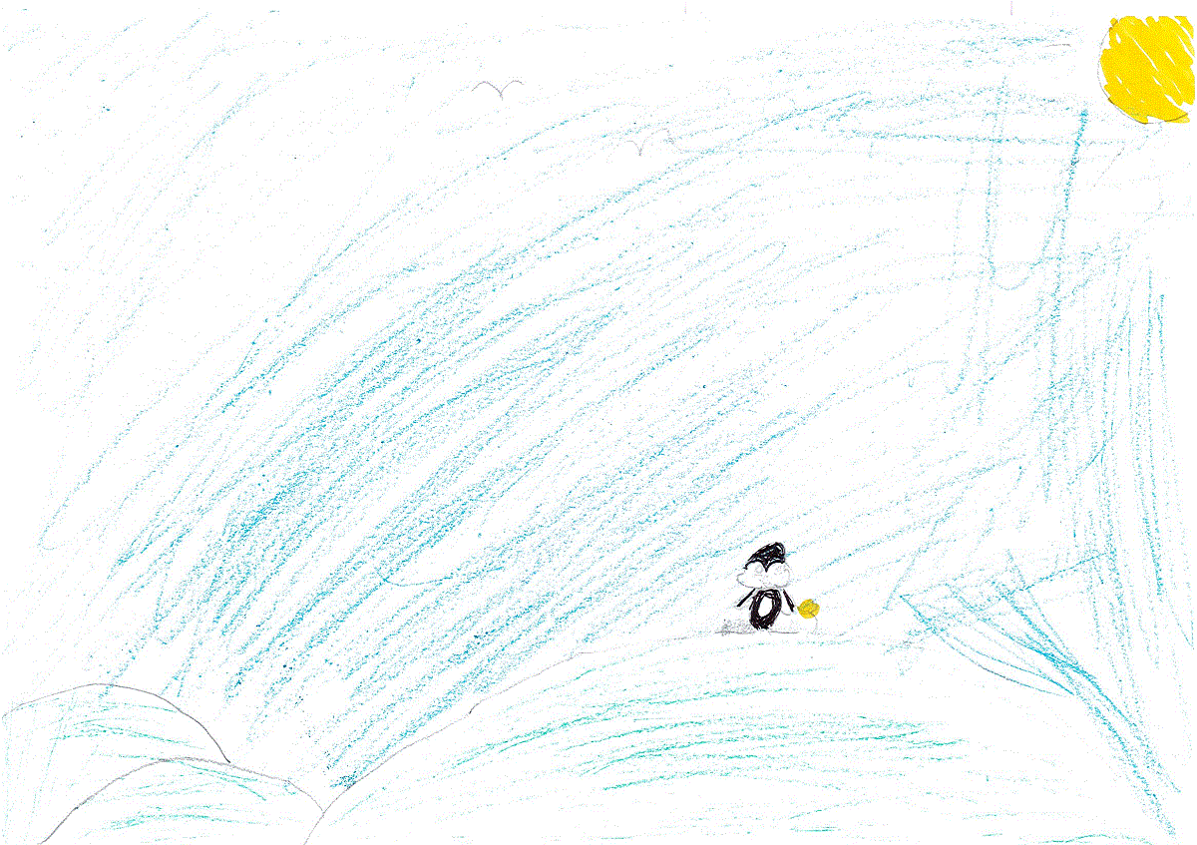

Fiona came to the 1000 steps and wondered what to do. She heard someone talking about a train called “Puffing Billy” so she decided to go there instead as those steps looked very tiring.
Click here to visit Puffing Billy.

Slide 18
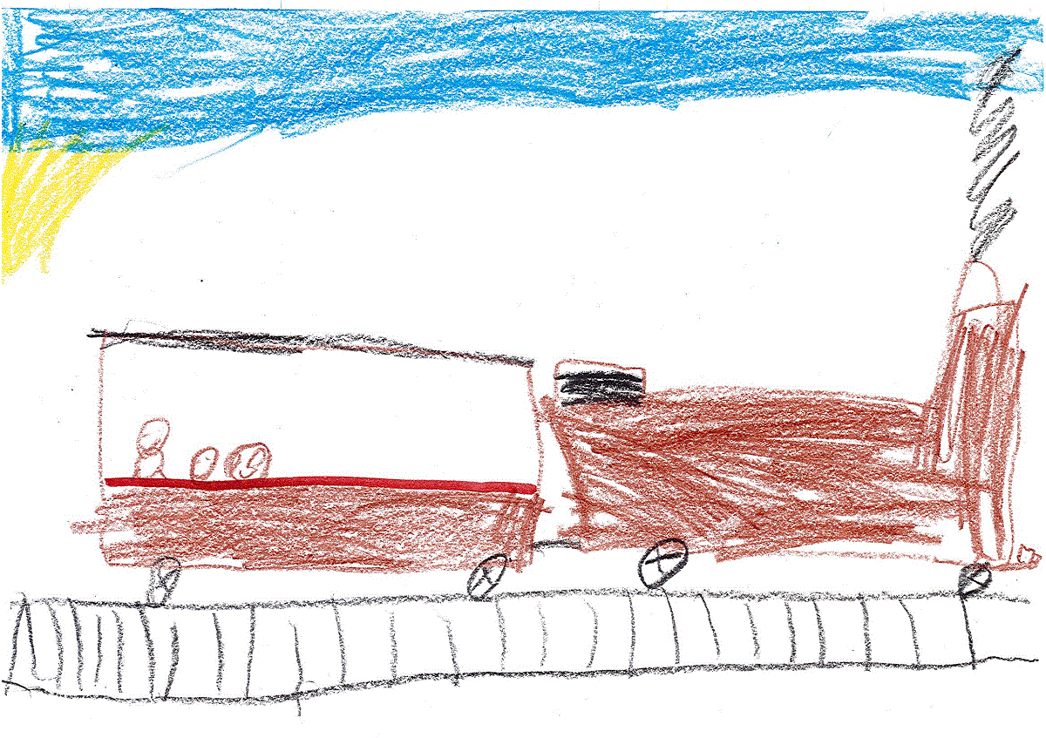
Fiona ended up at Puffing Billy in the Dandenong Mountains where a man called “Mr Jacobs” was driving the train.
Should she go for a ride or stay where she is?

Slide 19
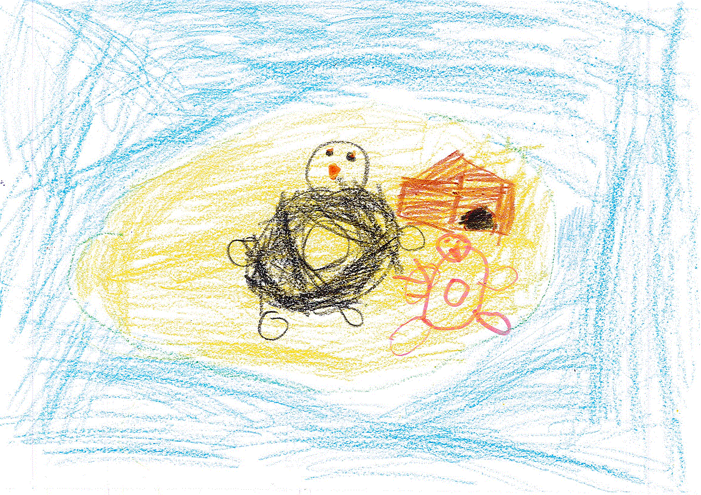
Flora took Fiona back to Phillip Island.
She was very happy to be back with her friends and family.
Click here to start again.

Slide 20
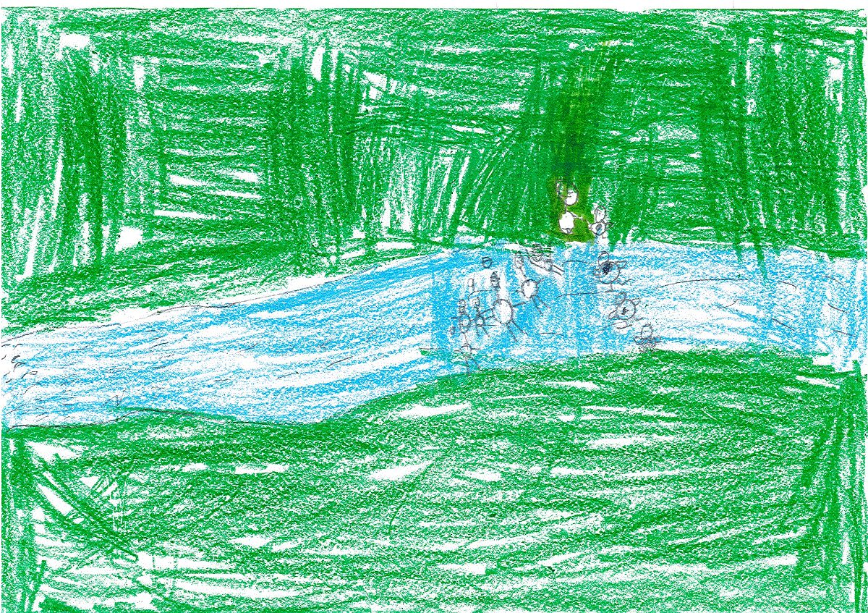
Fiona came to the Yarra River but she didn’t like it because it was fresh water instead of salt water. Fiona was clever enough to know that it might lead to salt water.
Should Fiona follow the river upstream or downstream?

Slide 21
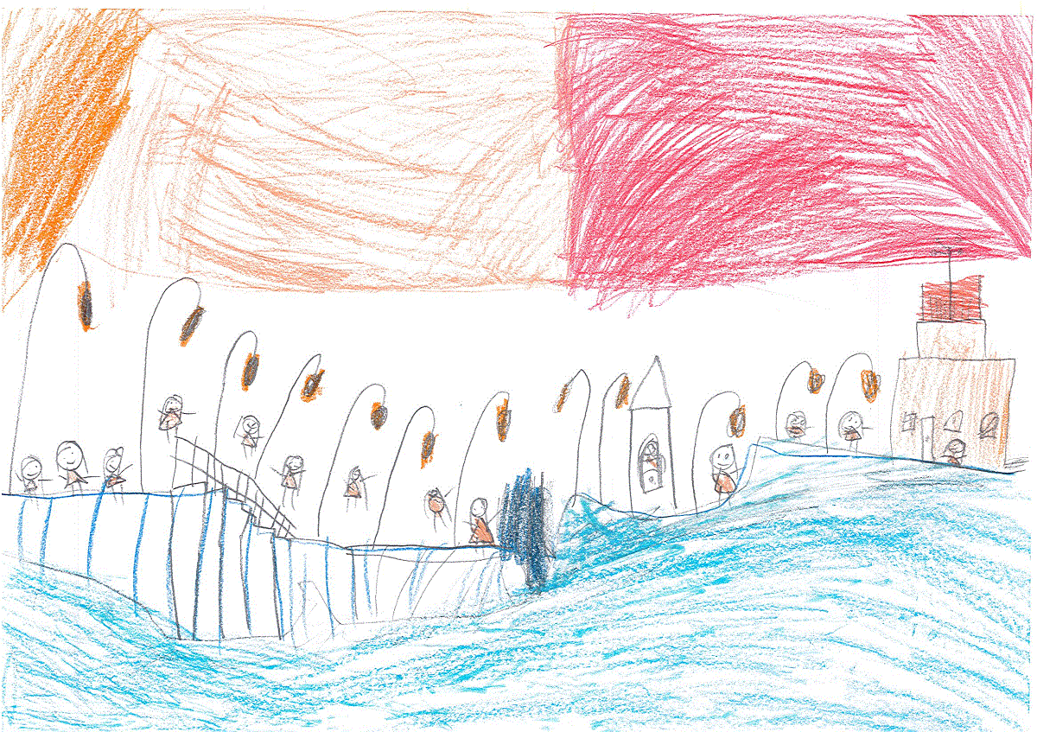
Fiona jumped into the Yarra River and let the current carry her down stream. Eventually, she ended up in Port Phillip Bay where she found some other fairy penguins living in St Kilda. Fiona lived happily ever after. The end.
Click here to start again.

Slide 22
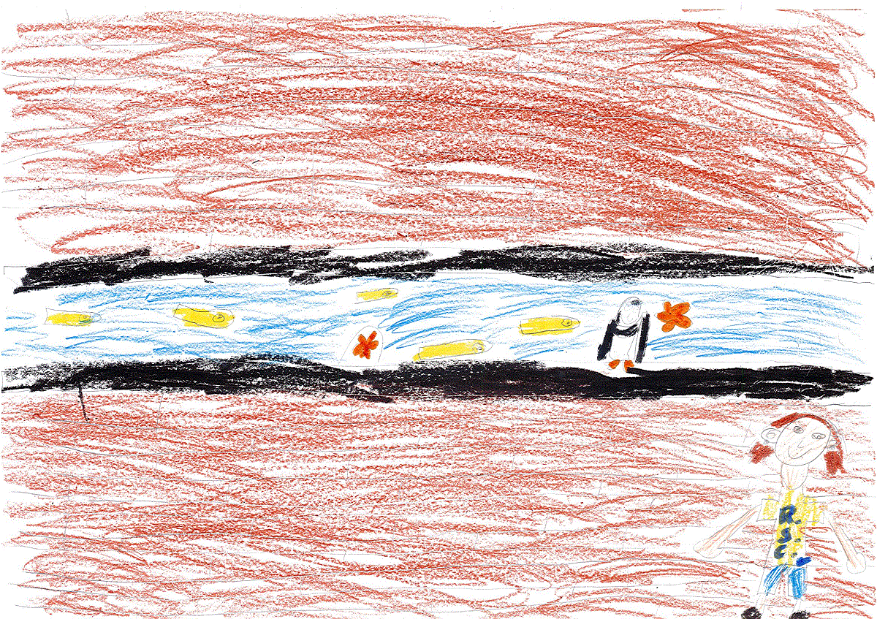
Lauren’s parents rang the RSPCA and they arranged to take Fiona to the Melbourne Aquarium. Lots of people got to see Fiona at the aquarium and they looked after her well. Fiona had finally found a safe home. The end.
Click here to start again

Slide 23
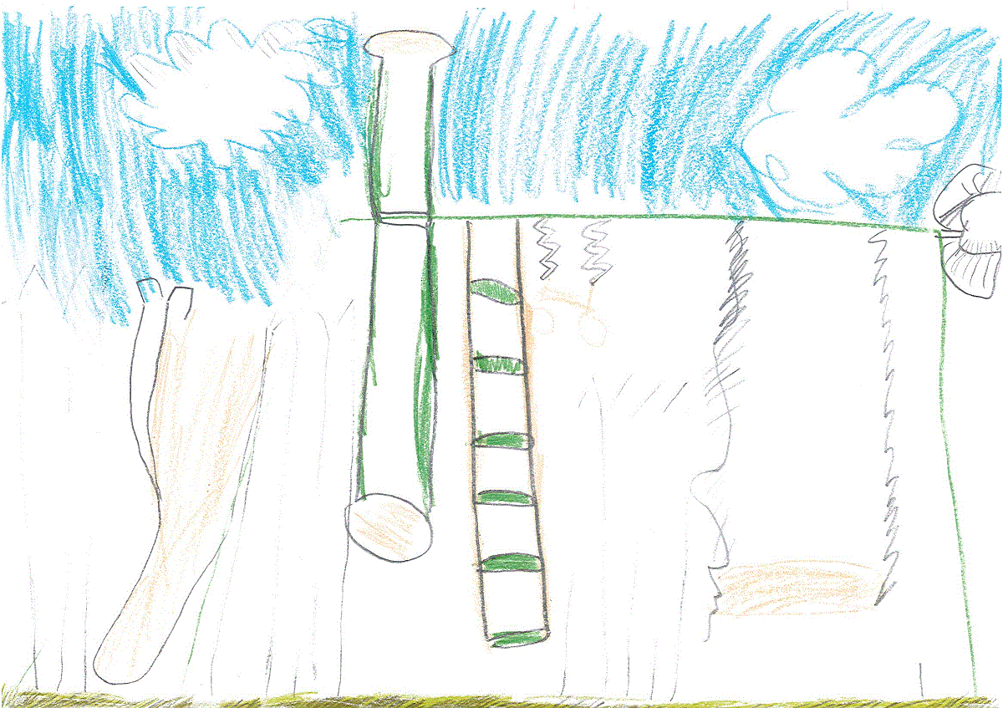
Fiona saw Lauren and her brother Zach playing in their backyard.
When Lauren’s parents came out and saw Fiona, they had to decide whether to:
Take her to the vet
Take her to the RSPCA.

Slide 24
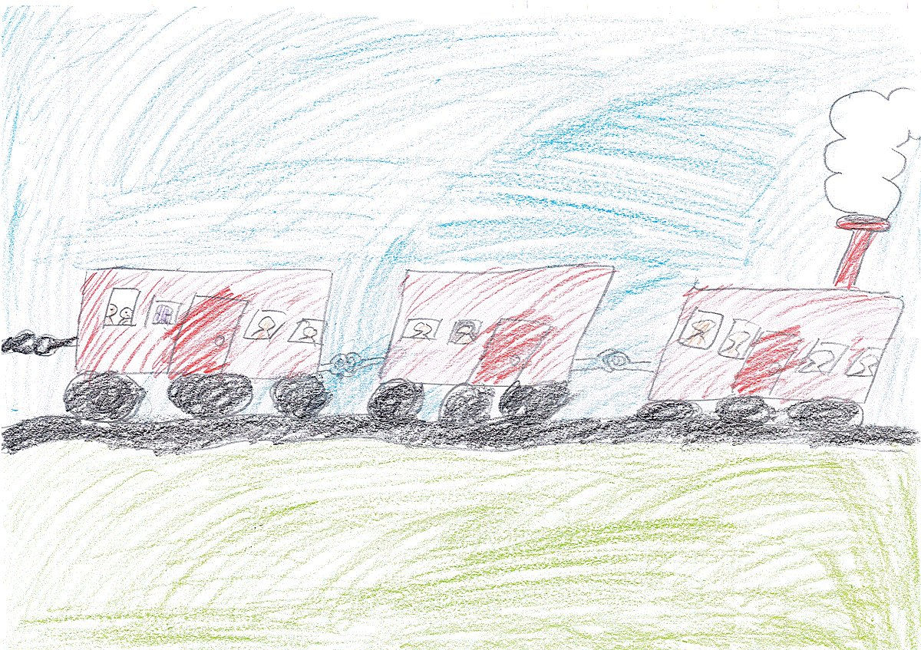
Fiona went for a ride on Puffing Billy but she was very scared as she had never been on a train before.
Click here to continue.

